Slide 1
XGBOOST REGRESSION

Slide 2
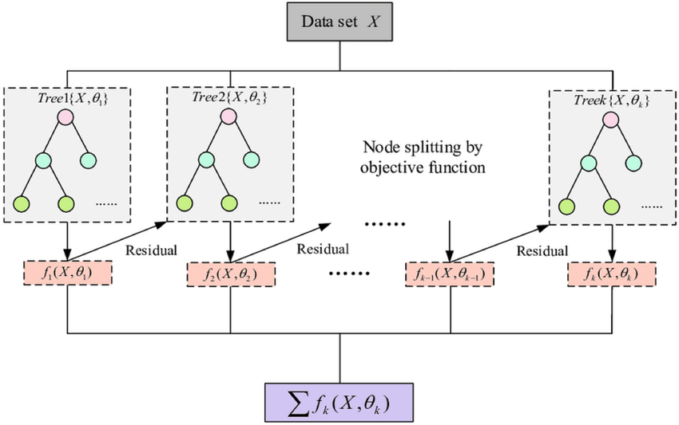
Xgboost is an ensemble techniques supervised learning and it uses the boosting technique.
It minimizes a loss function by sequentially building trees and improving predictions iteratively. The decision tree gets trained based on the residual values.

Slide 3
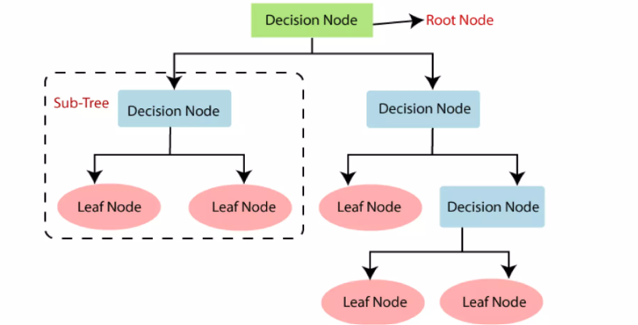
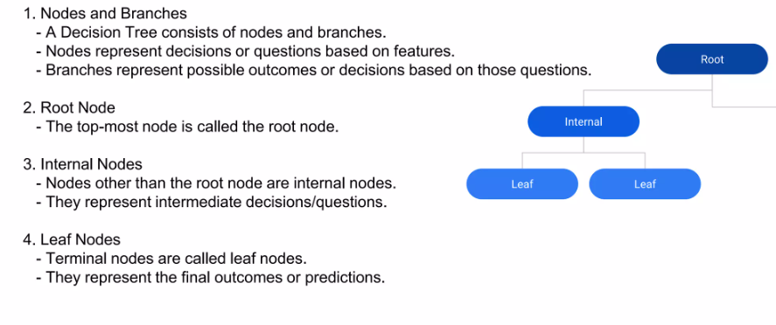

Slide 4
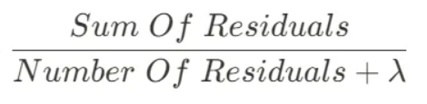
How XGBOOST Works:
Step-1 : Find the base model(average of the output field)
Step-2 : Calculate the Residual(output value – average value)
Step-3 : Built the Decision binary tree with the help of input values along with the found residual values
Step-6 :Predict the output:
Base Model+0.50 * t1+….
[Note: t value calculated using: sum of residuals of tree/total num of residual]
Step-5 :Calculate the Gain :
Left node weight+ Right node weight-root node weight
Step-4 :Calculate the similarity weight for left, right, root node:
Repeat steps from 2- 6, we will build another tree with new residuals and make a prediction, we keep building trees until the residuals are super small, or we have reached the maximum number.

Slide 5
Pros:
combining multiple models leads to superior accuracy compared to single models like decision trees
It’s optimized for handling large datasets and Helps prevent overfitting. The training speed is also faster.
XGBoost provides insights into feature importance. This helps understand which factors significantly impact the predictions.
Automatically identifies the most important features and prunes unnecessary ones.
Cons:
Compared to simpler models, XGBoost can be more complex to understand and fine-tune.
Potential for Overfitting.
XGBoost may not perform well on small datasets compared to simpler models.
Requires careful tuning of parameters like learning rate, max depth, and number of estimators to achieve optimal performance.

